Slide 1
Design Patterns – Elements of Reusability and Knowledge Transfer
Software Design & Architecture

Slide 2
What is a Pattern?
Pattern is “an idea that has been useful in one practical context and will probably be useful in others”.
A pattern addresses a recurring design problem that arises in specific design situations, and presents a solution to it.
  i.e., supporting variability in user interfaces
Patterns document existing, well-proven design experience.
Patterns identify and specify abstractions that are above the level of single classes and instances, or of components

Slide 3
What is a Pattern?
Patterns provide a common vocabulary and understanding for design principles
patterns are a means of documenting software architectures.
Patterns support the construction of software with defined properties.
Patterns help you build complex and heterogeneous software architectures.
Patterns help you to manage software complexity

Slide 4
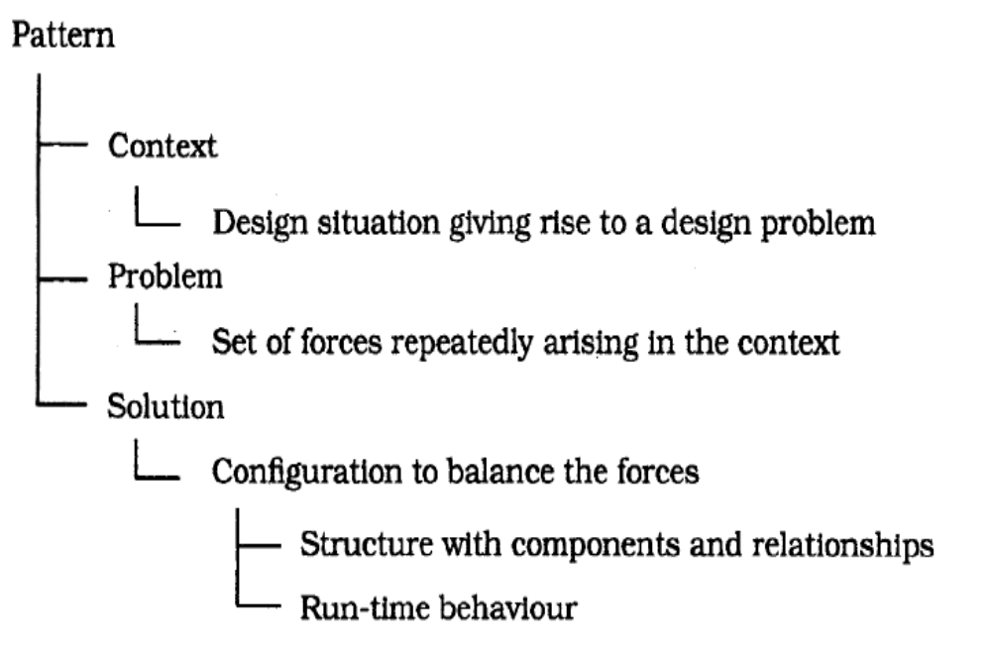
Overall structure of a Pattern
Each pattern is a three-part rule, which expresses a relation
between a certain context, a problem, and a solution.

Slide 5
Categories of Patterns
Architectural Patterns
Design Patterns
Idioms

Slide 6
Architectural Pattern
An architectural pattern expresses a fundamental structural organization schema for software systems. It provides a set of predefined subsystems, specifies their responsibilities, and includes rules and guidelines for organizing the relationships between them.
Act as templates for a complete software architecture
It is a fundamental design decision
Architecture of the subsystems is also affected by the architectural pattern

Slide 7
Design Pattern
A design pattern provides a scheme for refining the subsystems or components of a software system, or the relationships between them. It describes a commonly-recurring structure of communicating components that solves a general design problem within a particular context.
Design patterns are medium-scale patterns.
These are independent of a particular programming language or programming paradigm.
Many design patterns provide structures for decomposing more complex services or components.
  Observer or Publisher-Subscriber

Slide 8
Idioms
An idiom is a low-level pattern specific to a programming language. An idiom describes how to implement particular aspects of components or the relationships between them using the features of the given language.
Idioms deal with the implementation of particular design issues.

Slide 9
Architectural Patterns
From mud to structure
Distributed systems
Interactive systems
Adaptable systems

Slide 10
Architectural patterns …
From Mud to Structure
Patterns in this category support a controlled decomposition of an overall system task into cooperating subtasks
Often we have a large set of requirements
Difficult to work with competing interests, overlapping aspects and problems
  “ball of mud”
Although system can be decomposed based on functionalities but one has to ensure quality attributes are met

Slide 11
Architectural patterns …
Distributed Systems
Patterns in this category provide infrastructure for distributed applications.
This category includes one pattern. Broker and refers to two patterns in other categories, Microkernel and Pipes and Filters.
Interactive Systems
patterns support the structuring of software systems that feature human-computer interaction.
Patterns include MVC and Presentation Abstraction Controller

Slide 12
Architectural patterns …
Adaptable Systems
Patterns that support extension of applications
These also support adaptability to evolving technology and changing functional requirements
Patterns include Reflection and MicroKernel

Slide 13
From Mud to Structure
Three categories of patterns
  The Layers pattern helps to structure applications that can be decomposed into groups of subtasks in which each group of subtasks is at a particular level of abstraction.
  The Pipes and Filters pattern provides a structure for systems that process a stream of data. Each processing step is encapsulated in a filter component. Data is passed through pipes between adjacent filters. Recombining filters allows you to build families of related systems.

Slide 14
From Mud to Structure
The Blackboard pattern is useful for problems for which no deterministic solution strategies are known. In Blackboard several specialized subsystems assemble their knowledge to build a possibly partial or approximate solution.

Slide 15
Layers Patterns
The layers architectural pattern helps to structure applications that can be decomposed into groups of subtasks in which each group of subtasks is at a particular level of abstraction.
Example
  Networking protocols are the best known examples of layered architecture
Context
  A large system that requires decomposition.

Slide 16
Layers Patterns … Problem
Problem
A system whose dominant characteristic is a mix of low- and high-level issues
high-level operations rely on the lower-level ones.
Such systems often also require some horizontal structuring that is orthogonal to their vertical subdivision.
Portability to other platform is also desired

Slide 17
Layers Patterns … Problem
There is a need to balance the forces like:
  Late source code changes should not ripple through the system. They should be confined to one component and not affect others.
  Parts of the system should be exchangeable
  Similar responsibilities should be grouped to help understandability and maintainability
  Complex components need further decomposition.

Slide 18
Layers Patterns … Solution
Divide the system into an appropriate number of layers and put them on top on each other
Most of the services at a particular layer (Layer J) are composed of the services provided by the next lower layer (Layer J-1)
It is essential that within an individual layer all constituent components work at the same level of abstraction.

Slide 19
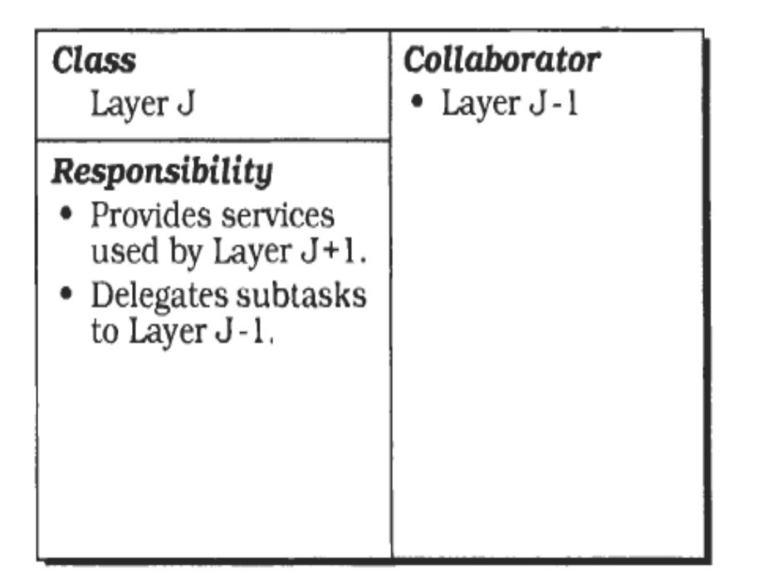
Layers Patterns … Structure
An individual layer can be described by the following CRC card

Slide 20
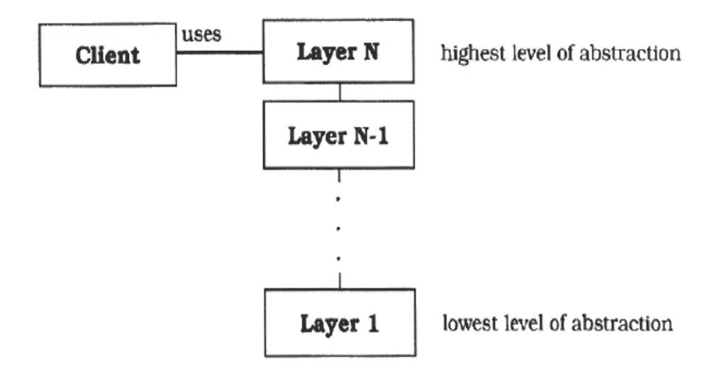
Layers Patterns … Structure

Slide 21
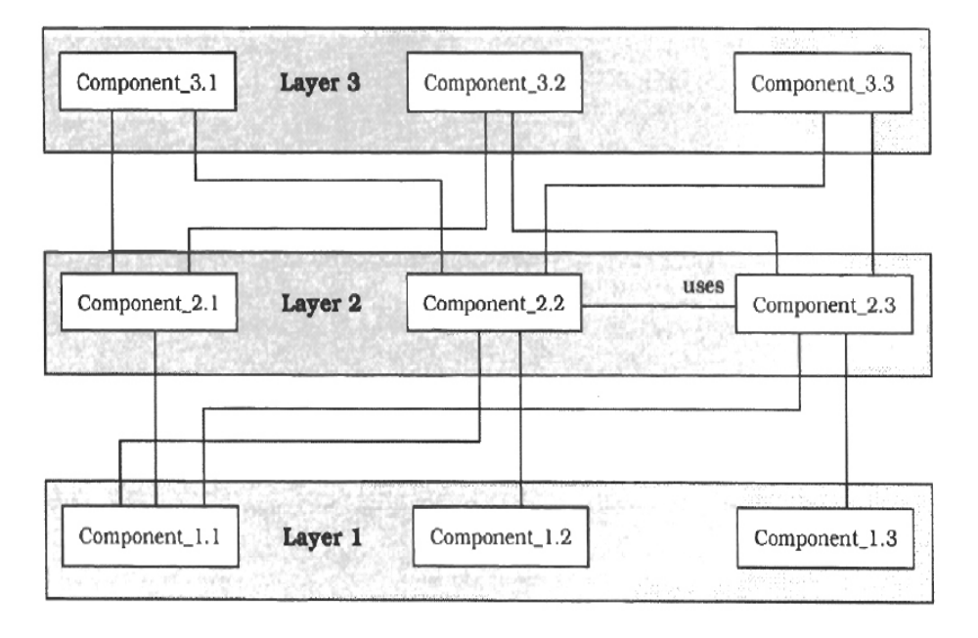
Layers Patterns … Structure

Slide 22
Layers Patterns … Dynamics
The following scenarios show the dynamic behaviour of a layered architecture
Scenario I
  A client Issues a request to Layer N.
  Layer N cannot carry out the request on its own, calls the next Layer N - 1 for supporting subtasks.
  Layer N-1 performs these tasks and may send request to the next lower layer
  Replies are passed back to next higher layer

Slide 23
Layers Patterns … Dynamics
Scenario II
  illustrates bottom-up communication
  chain of actions starts at Layer 1, for example when a device driver detects input.
  Layer 1 translates the i/p to an internal format and transmits it to the next higher layer
  The bottom-up transmission is termed as ‘notifications’
    The other way round is ‘requests’

Slide 24
Layers Patterns … Implementation
A step wise refinement approach
Not all the steps are mandatory
  Define the abstraction criterion
  Determine the number of abstraction levels
  Name the layers and assign tasks to each of them
  Specify the services

Slide 25
Layers Patterns … Implementation
  Refine the layering.
  Specify an interface for each layer
  Structure individual layers
  Specify the communication between adjacent layers.
  Decouple adjacent layers
  Design an error-handling strategy

Slide 26
Layers Patterns …
Examples & Variants
  Explore yourself (refer to the references at the end)
Known Uses
  Virtual Machines.
  APIs
  Information Systems (IS)
  Windows Enterprise Operating Systems (NT, 2000, XP, Server ) (structured as Mickernel Pattern)

Slide 27
Layers Patterns … Consequences
Benefits
    Reuse of layers.
    Support for standardization.
    Dependencies are kept local.
    Exchangeability.
Liabilities
    Cascades of changing behaviour
    Lower efficiency.
    Unnecessary work.
    Difficulty of establishing the correct granularity of layers.

Slide 28
Few more architectural patterns ..
Distributed Systems
  Pipes and filters pattern [mud and structure]
  Microkernel pattern [adaptable systems]
  Broker pattern
Interactive Systems
  Model-View-Controller pattern
  Presentation-Abstraction-Control pattern
Adaptable systems
  Microkernel pattern
  Reflection pattern

Slide 29
Model View Controller (MVC)
The Model-View-Controller architectural pattern (MVC) divides an interactive application into three components.
  The model contains the core functionality and data.
  Views display information to the user.
  Controllers handle user input.
Views and controllers together comprise the user interface.
A change-propagation mechanism ensures consistency between the user interface and the model.

Slide 30
MVC - Context
Interactive applications with a flexible human-computer interface.

Slide 31
MVC - Problem
User interfaces are especially prone to change requests.
A customer may call for a specific user interface adaptation,
A system may need to be ported to another platform with a different 'look and feel' standard.
Different users place conflicting requirements on the user interface.
If the user interface is tightly interwoven with the functional core, changes become difficult

Slide 32
MVC – Problem …
The following forces influence the solution:
  The same information is presented differently in different windows, for example, in a bar or pie chart.
  The display and behavior of the application must reflect data manipulations immediately.
  Changes to the user interface should be easy and even possible at run-time.
  Supporting different 'look and feel' standards or porting the user interface should not affect code in the core of the application.

Slide 33
MVC - Solution
Model-View-Controller (MVC] was first introduced in the Smalltalk-80 programming environment.

Slide 34
Components
The model component encapsulates core data and functionality. The model is independent of specific output representations or input behavior.
View components display information to the user. A view obtains the data from the model. There can be multiple views of the model.
Controllers receive input, usually as events that encode mouse movement, activation of mouse buttons, or keyboard input. Events are translated to service requests for the model or the view. The user interacts with the system solely through controllers.

Slide 35
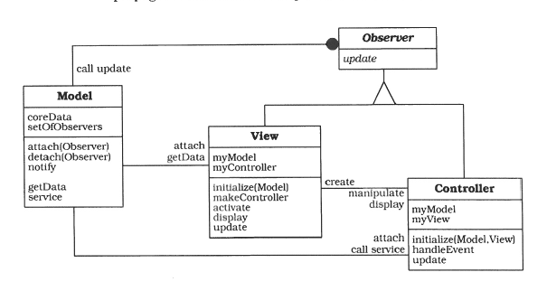
MVC-Structure

Slide 36
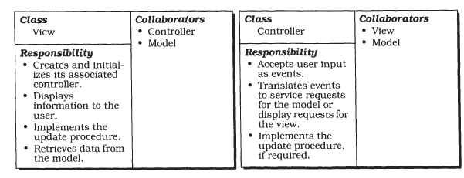
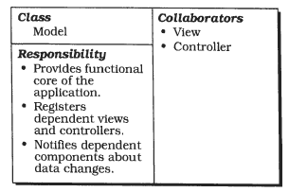

Slide 37
MVC - Dynamics
Scenario I shows how user input that results in changes to the model triggers the change-propagation mechanism:
  The controller accepts user input in its event-handling procedure, interprets the event, and activates a service procedure of the model.
  The model performs the requested service. This results in a change to its internal data.
  The model notifies all views and controllers registered with the change-propagation mechanism of the change by calling their update procedures.
  Each view requests the changed data from the model and redisplays itself on the screen.
  Each registered controller retrieves data from the model to enable or disable certain user functions. For example, enabling the menu entry for saving data can be a consequence of modifications to the data of the model.
  The original controller regains control and returns from its event handling procedure.

Slide 38
MVC - Benefits
Multiple views of the same model.
Synchronized views.
'Pluggable' views and controllers.
Exchangeability of 'look and feel'.
Framework potential.

Slide 39
MVC - Liabilities
Increased complexity
Potential for excessive number of updates.
Intimate connection between view and controller.
Close coupling of views and controllers to a Model

Slide 40
Presentation Abstraction Control (PAC)
The Presentation-Abstraction-Control architectural pattern (PAC) defines a structure for interactive software systems in the form of a hierarchy of cooperating agents.
Every agent is responsible for a specific aspect of the application's functionality and consists of three components:
    presentation,
    abstraction,
    and control.
This subdivision separates the human-computer interaction aspects of the agent from its functional core and its communication with other agents.

Slide 41
Presentation Abstraction Control (PAC) …
Context
Development of an interactive application with the help of agents
Problem
Agents specialized in human-computer interaction accept user input and display data.
Other agents maintain the data model of the system and offer functionality that operates on this data.
Additional agents are responsible for diverse tasks such as error handling or communication with other software systems

Slide 42
Problem …
The following forces affect the solution:
  Agents often maintain their own state and data. For effective communication they need to communicate with each by exchanging data, events and messages
  Interactive agents provide their own user interface,
  Systems evolve over time, changes to the individual agents or extension to the system by introducing new agents should not affect the system functionality

Slide 43
PAC … Solution
Structure the interactive application as a tree-like hierarchy of PAC agents
There should be one top-level agent, several intermediate level agents, and even more bottom-level agents.
Every agent responsible for a specific aspect of application functionality and consisting of three parts: P-A-C

Slide 44
Presentation: Visible behaviour of the agent
Abstraction: data model and related functionality (business logic)
Control: connects the presentation and abstraction components of the agent and provides communication with other agents.

Slide 45
Top Level PAC Agent
  Functional core of the systems
  Includes parts of the UI that are common and not dependent on a particular sub-task
Intermediate-level PAC
  Represents the combination of or relationship between low-level agents
    Several views of the same data
Bottom-level PAC Agent
  Self contained semantic concepts on which a user can act (atomic functionalities)
  Zooming in, working on spreadsheets

Slide 46
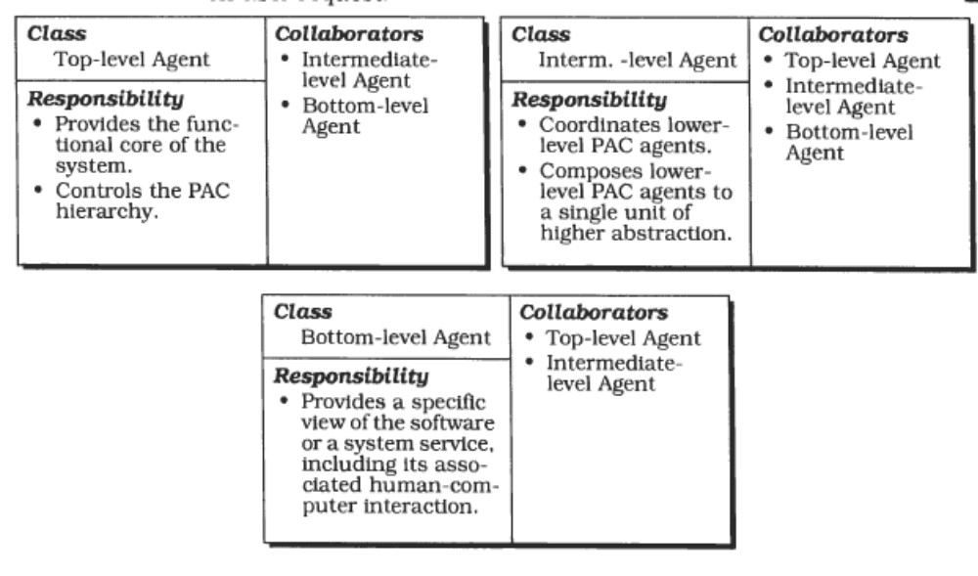

Slide 47
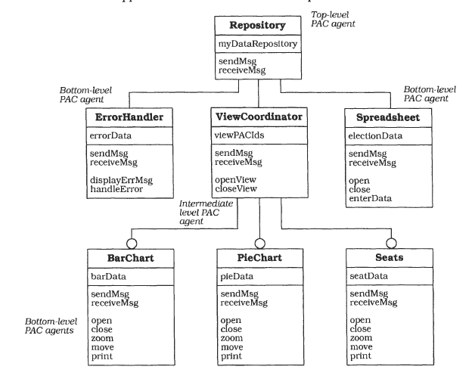

Slide 48
References and further reading
‘Pattern Oriented Software Architecture: A System of Patterns’ by Buschmann et al. (1996). [chapter 1 & 2).
For further reading
‘Design Patterns: Elements of Reusable Object-Oriented Software’ by Gamma et al. (or GOF)
‘Design Patterns Explained: A new perspective on Object-Oriented Design’, 2nd Ed., by Alan Shalloway and James R. Trott (2005)

